Slide 1
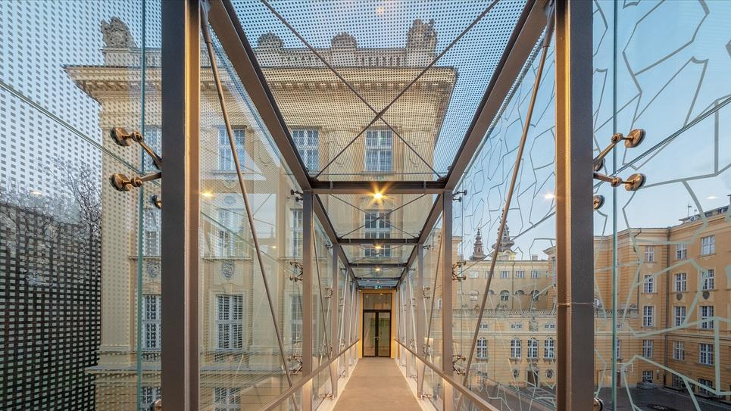
Welcome to the Szent Imre Secondary School
Get to know the Scout Troop & Alumni leaders
26.11.2024
Notes:
Father Augustine, father Thomas on behalf of the alumni and the scout troop, please be welcome to the Szent Imre Secondary School here in Budapest.

Slide 2

Scouting at
Szent Imre
Secondary School
Notes:
My name is Ábel Somogyi, I am the deputy-director of the 25th Szent Imre (Saint Emericus) Scout Troop

Slide 3
Scouting at Szent Imre - Agenda
1.About the 25th Szent Imre Scout Troop
2.Pillars of the Scout Method
3.Scouting in Action - Activities
4.Our Aim and Impact
5.How we collaborate with the School
Notes:
First i will introduce to you scouting and our scout troop, than i will talk about the foundations of how we educate children, after, i will introduce our programs and activities, that i will try to show our aim and impact, and lastly i will put forward our main areas of collaboration with the School.

Slide 4
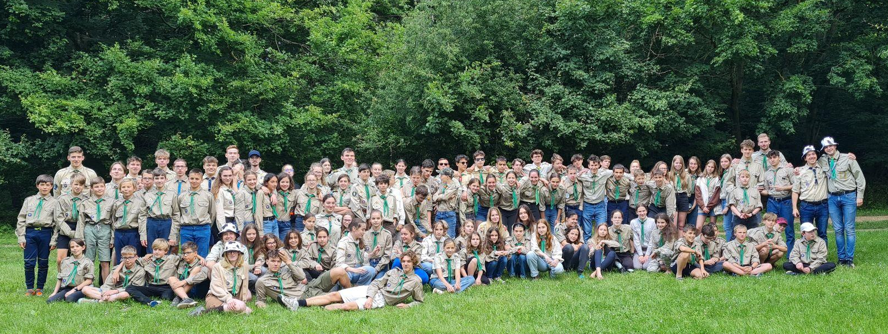
About the 25th Szent Imre Scout Troop
Since 1920
“a voluntary non-political educational movement for young people open to all”
Founded and functioning at Szt. Imre
More than 1000 alumni
50+ volunteer leaders
300 active members
Notes:
Scouting is: …. we were founded more than 100 years ago here at Szent Imre Secondary school, and we have been functioning here ever since - of course with a pause during the wars. We have currently a more than 1000 strong alumni since our re-establishment in 1989. At the moment we have 300 active members who participate regularly in our activities, and 50 leaders between the age of 16-22, that help organize the everyday life of our troop.

Slide 5
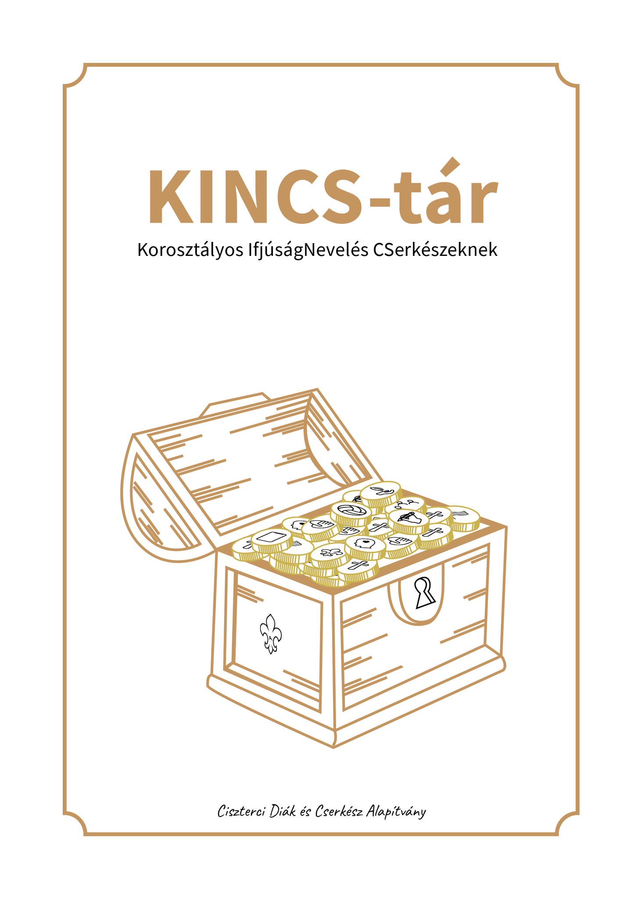
Pillars of the Scout Method
Age-specific tasks in 10 educational areas:
Scouting knowledge
Emotional intelligence
Social sensitisation
Spiritual education
Healthy lifestyle
Aesthetic education
Media use
Citizenship and financial literacy
Environmental awareness
Social skills
“Try to leave this world a little better than you found it”
/Bi-Pi/
Notes:
The pillars of the scout method lie on the foundation of this quote by baden-powell, the founder of scouting, “try to leave this world a little better than you found it”. Our youth education method differs from other scouting programs in hungary, since a few years ago we compiled a book that you can see here on the slide. The book consists of age specific task in 10 education areas: ……

Slide 6
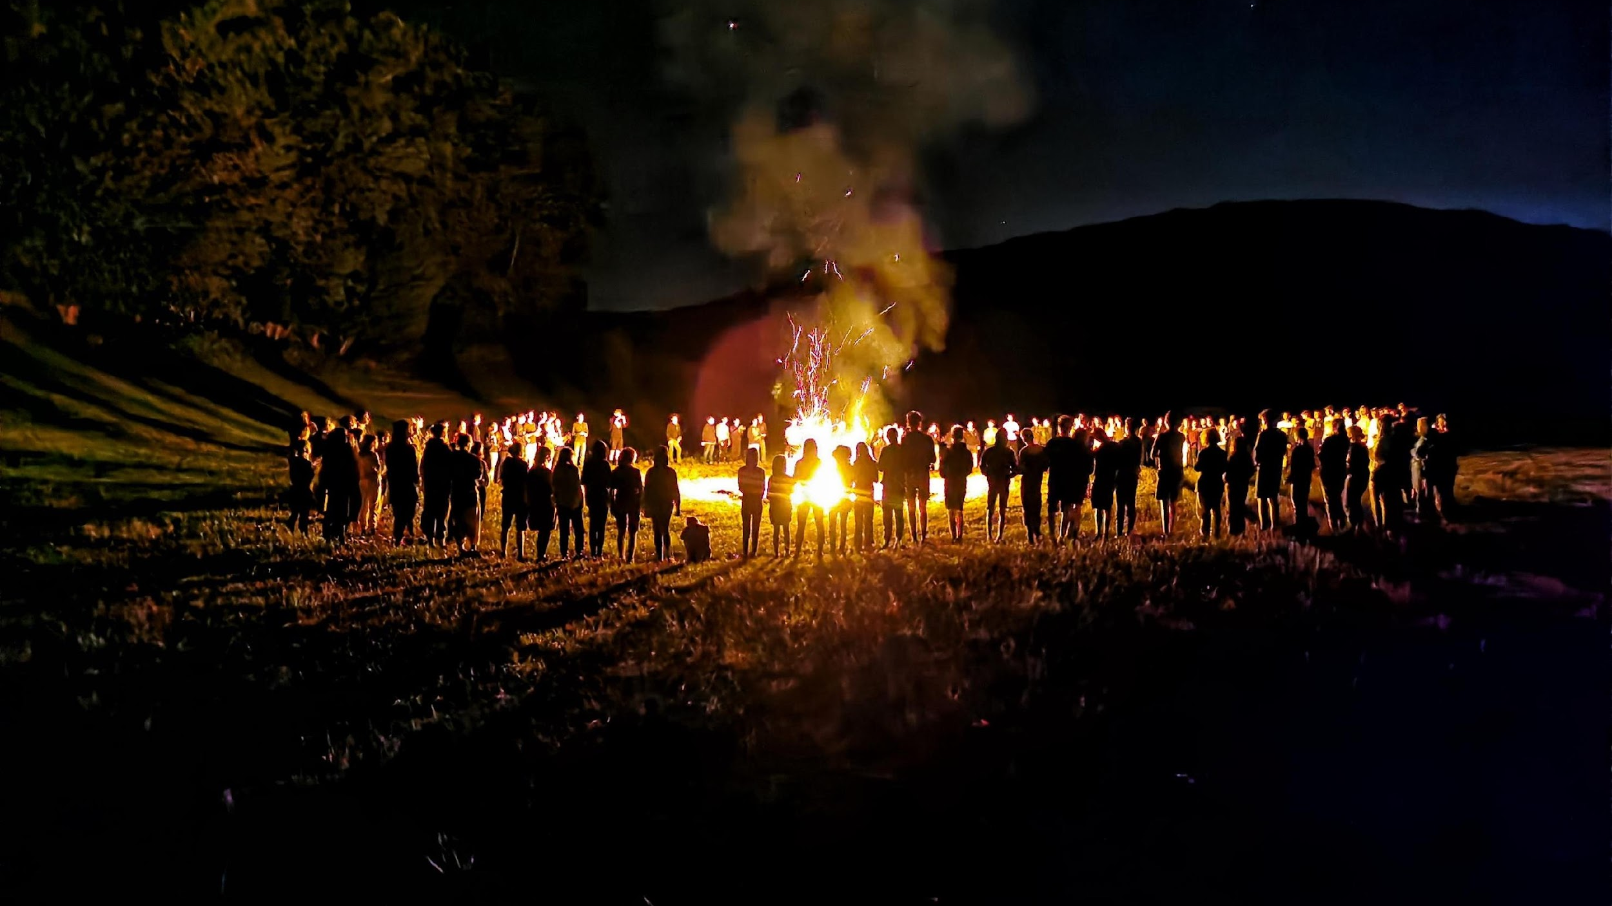
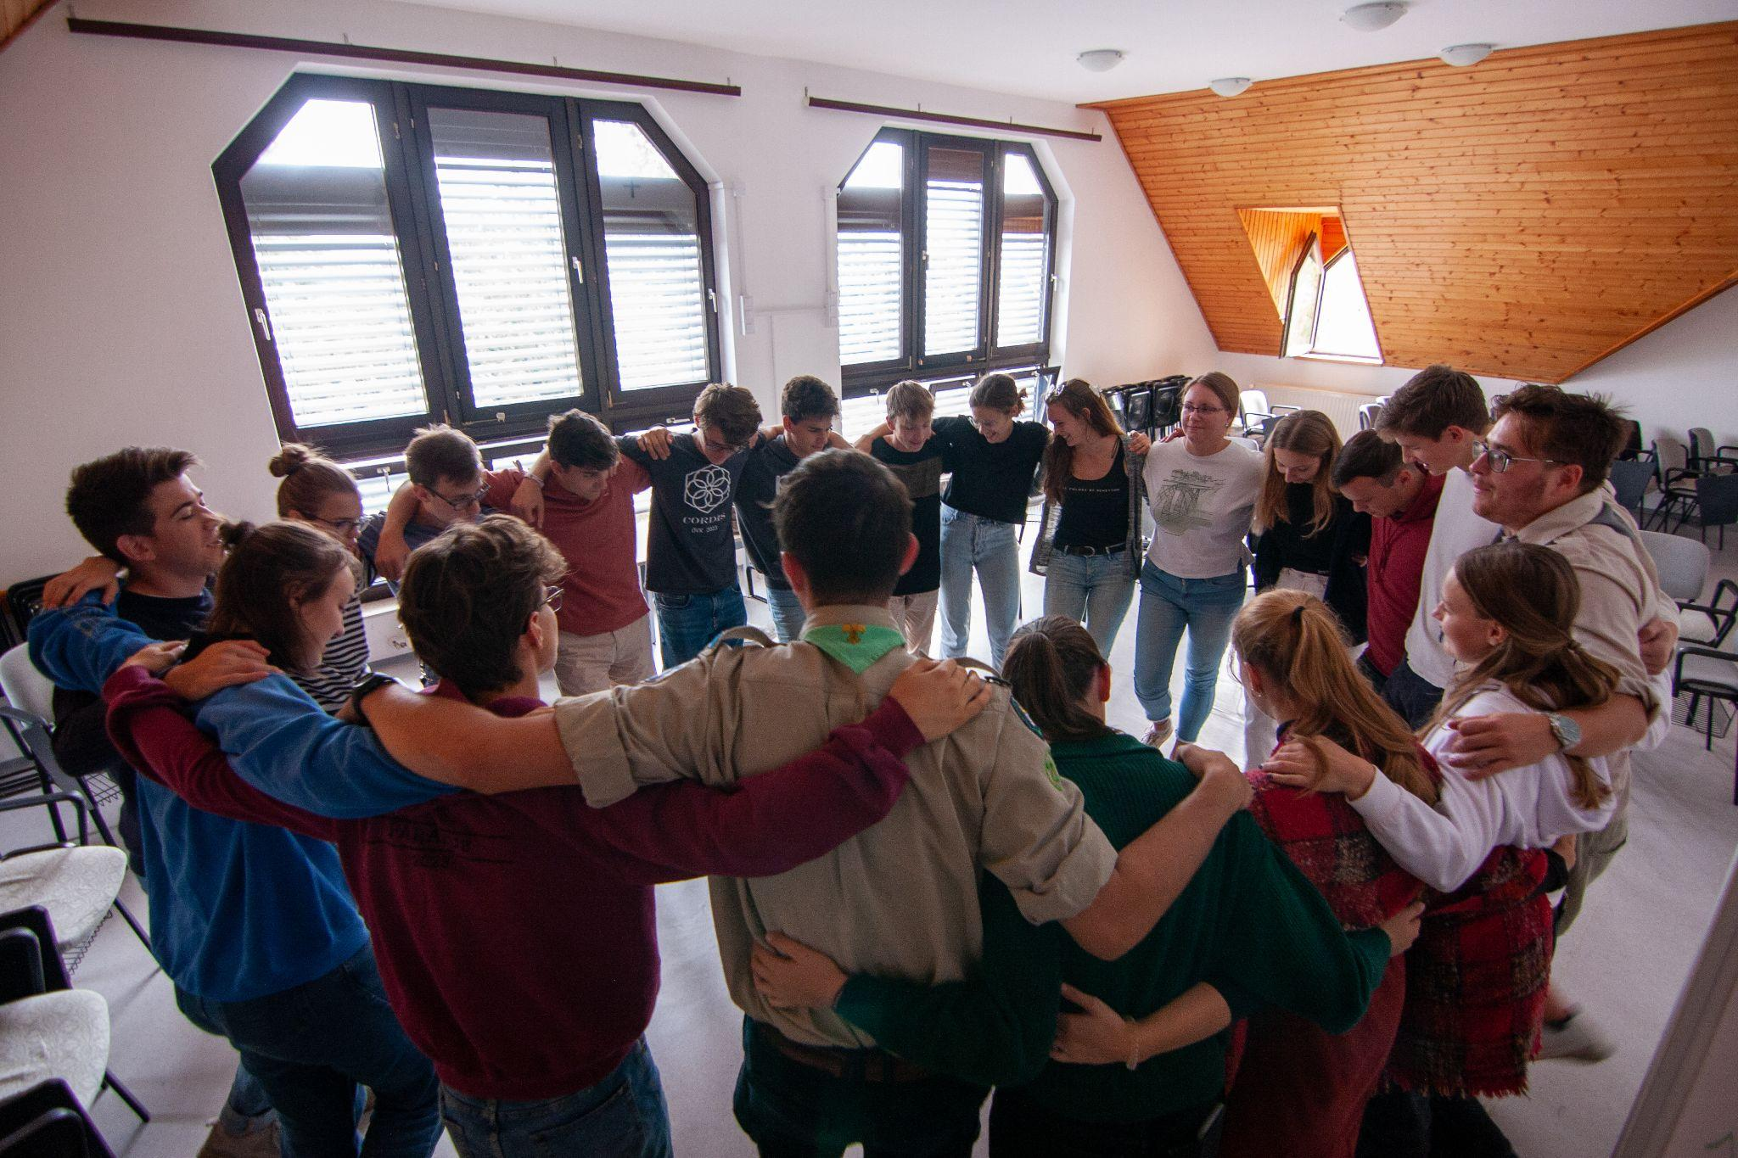
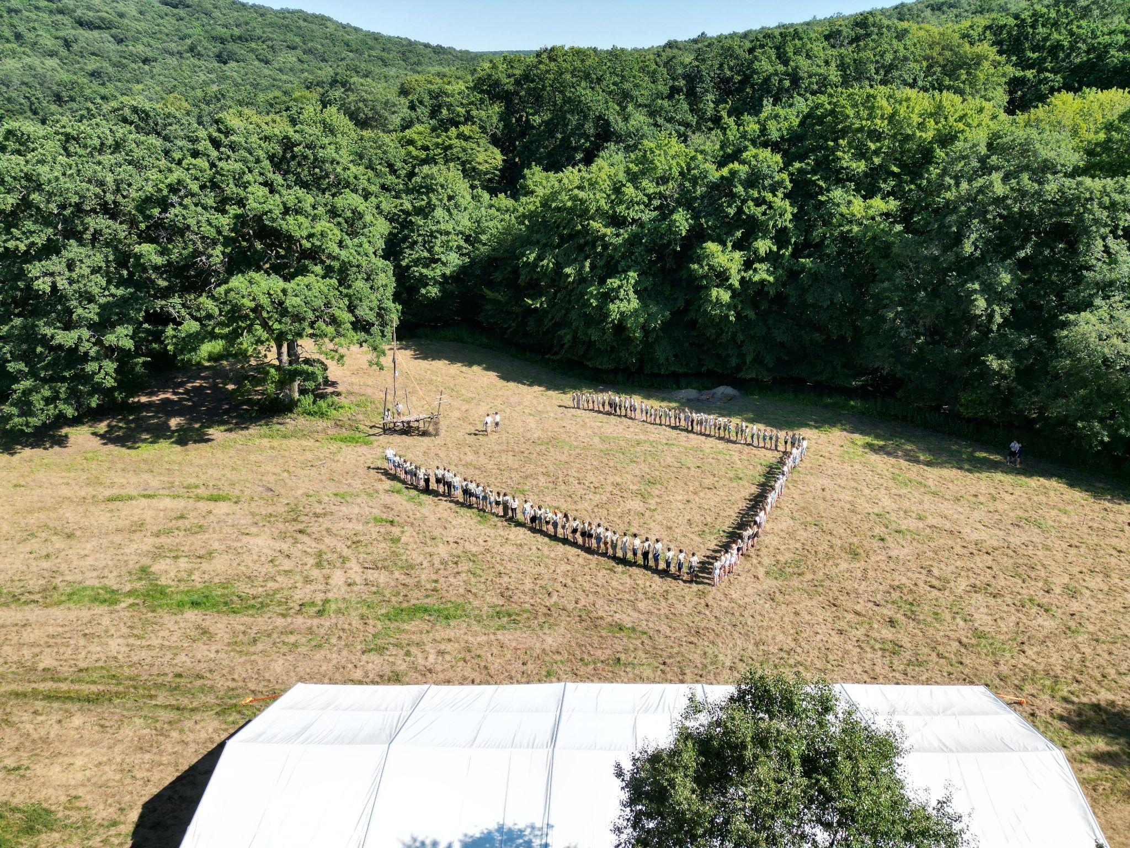
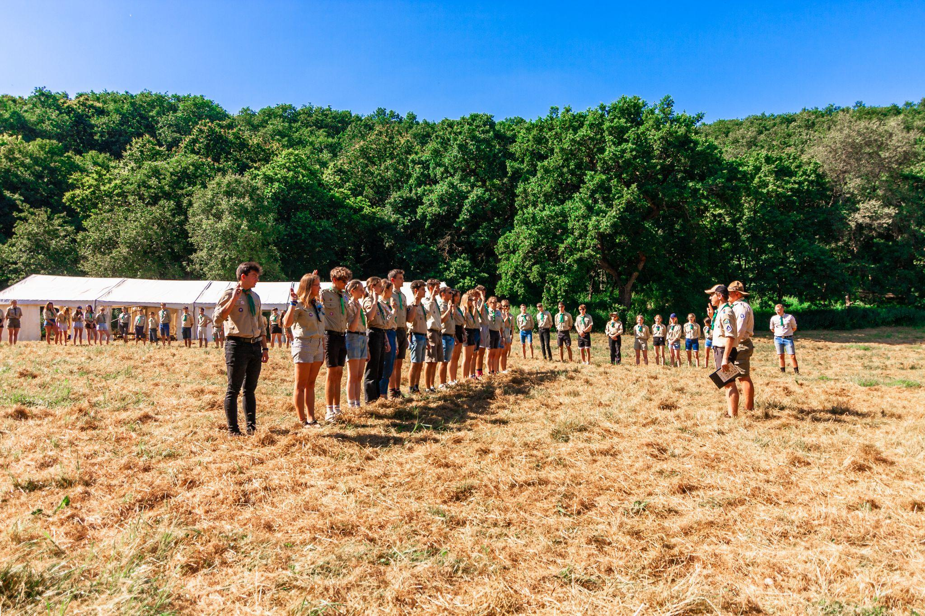
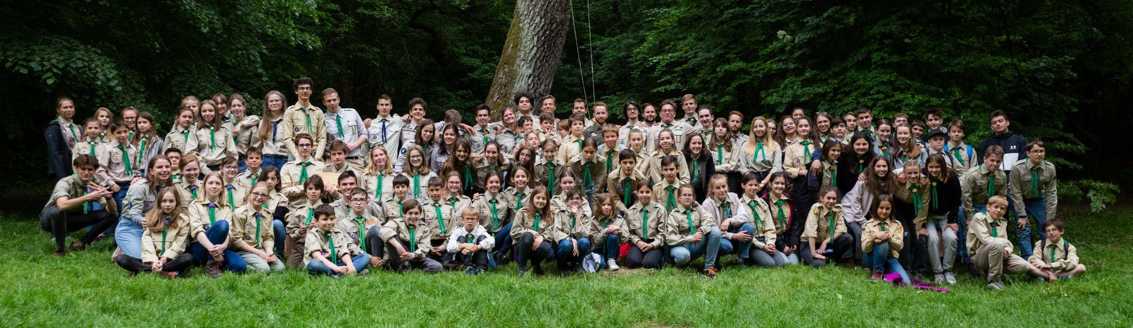
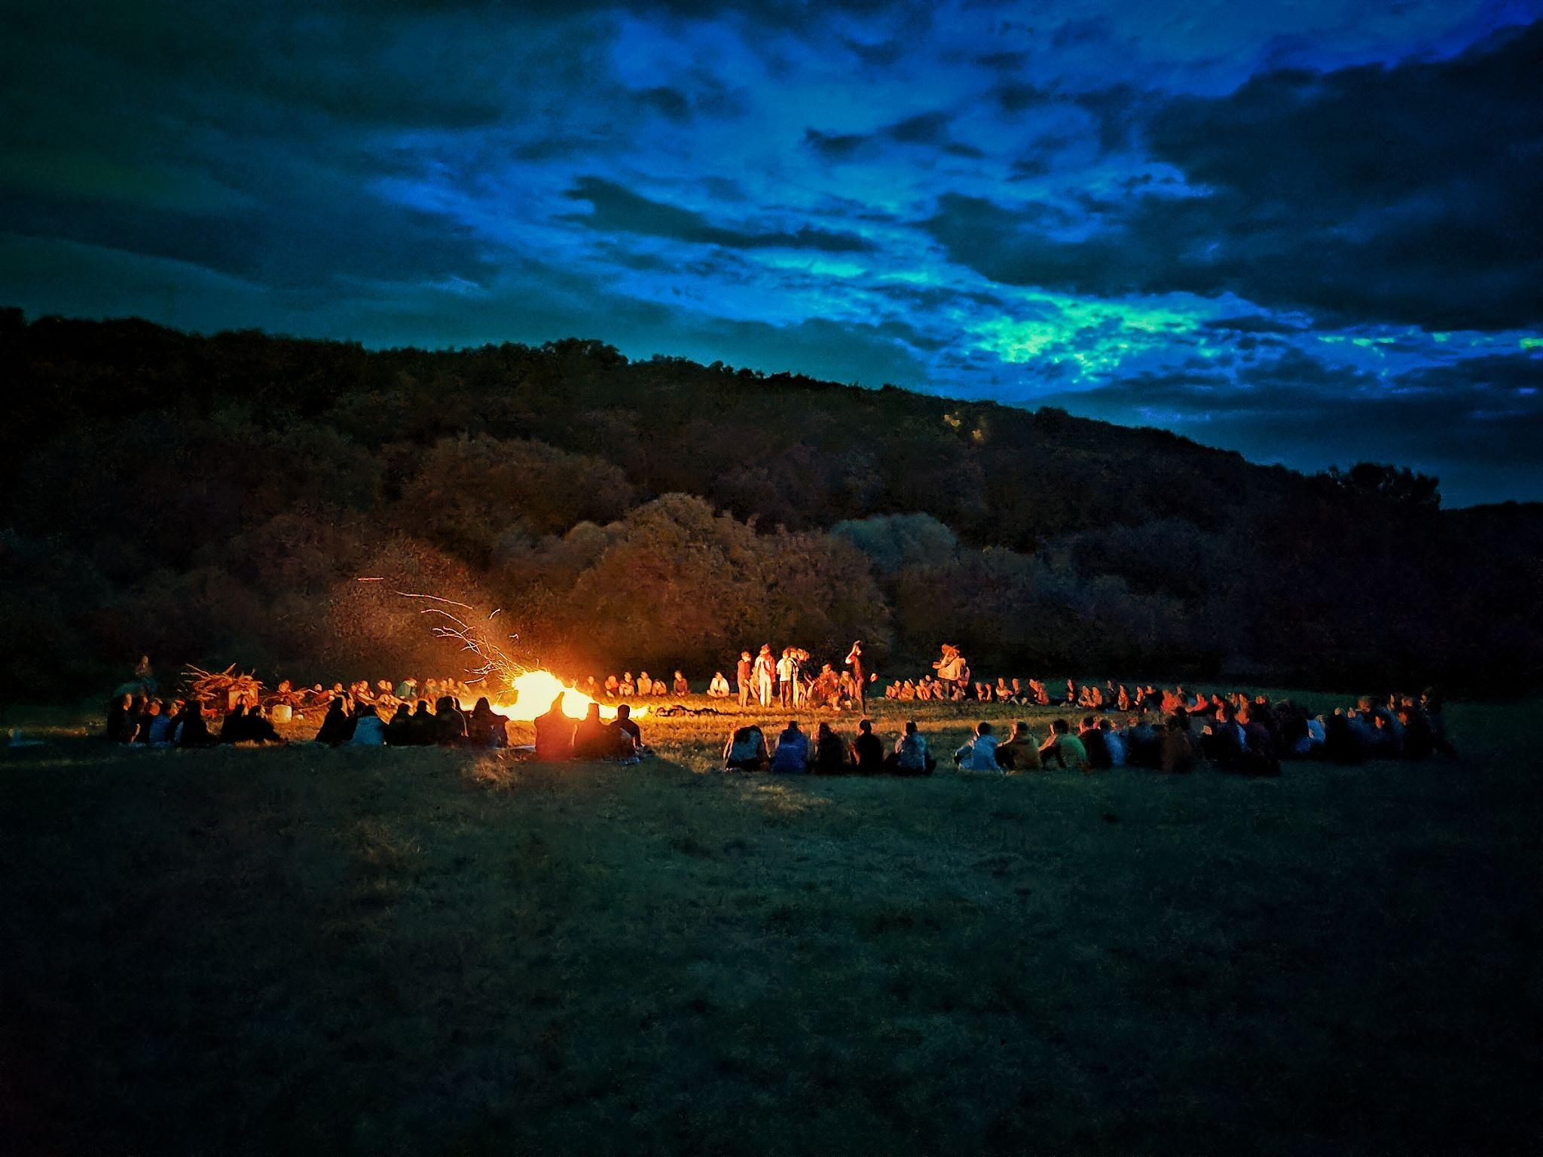
Scouting in Action - Our Activities
“Learn by doing”!
weekly assemblies
10 day nomad camp
weekend getaways
Notes:
The goal behind our activities can be best summarized with our core belief: Learn by doing! Our main interface with the children are the weekly assemblies, where are voluntary scout leaders hold 1.5-2 hours long sessions filled with activities from the book that I have mentioned on the slide before, as well as other playful activities to help build community. We aim to bring youngsters out in the nature as much as possible, so we organize weekend getaways.The main event of the year is the 10 day long fully-nomad scouting camp.

Slide 7
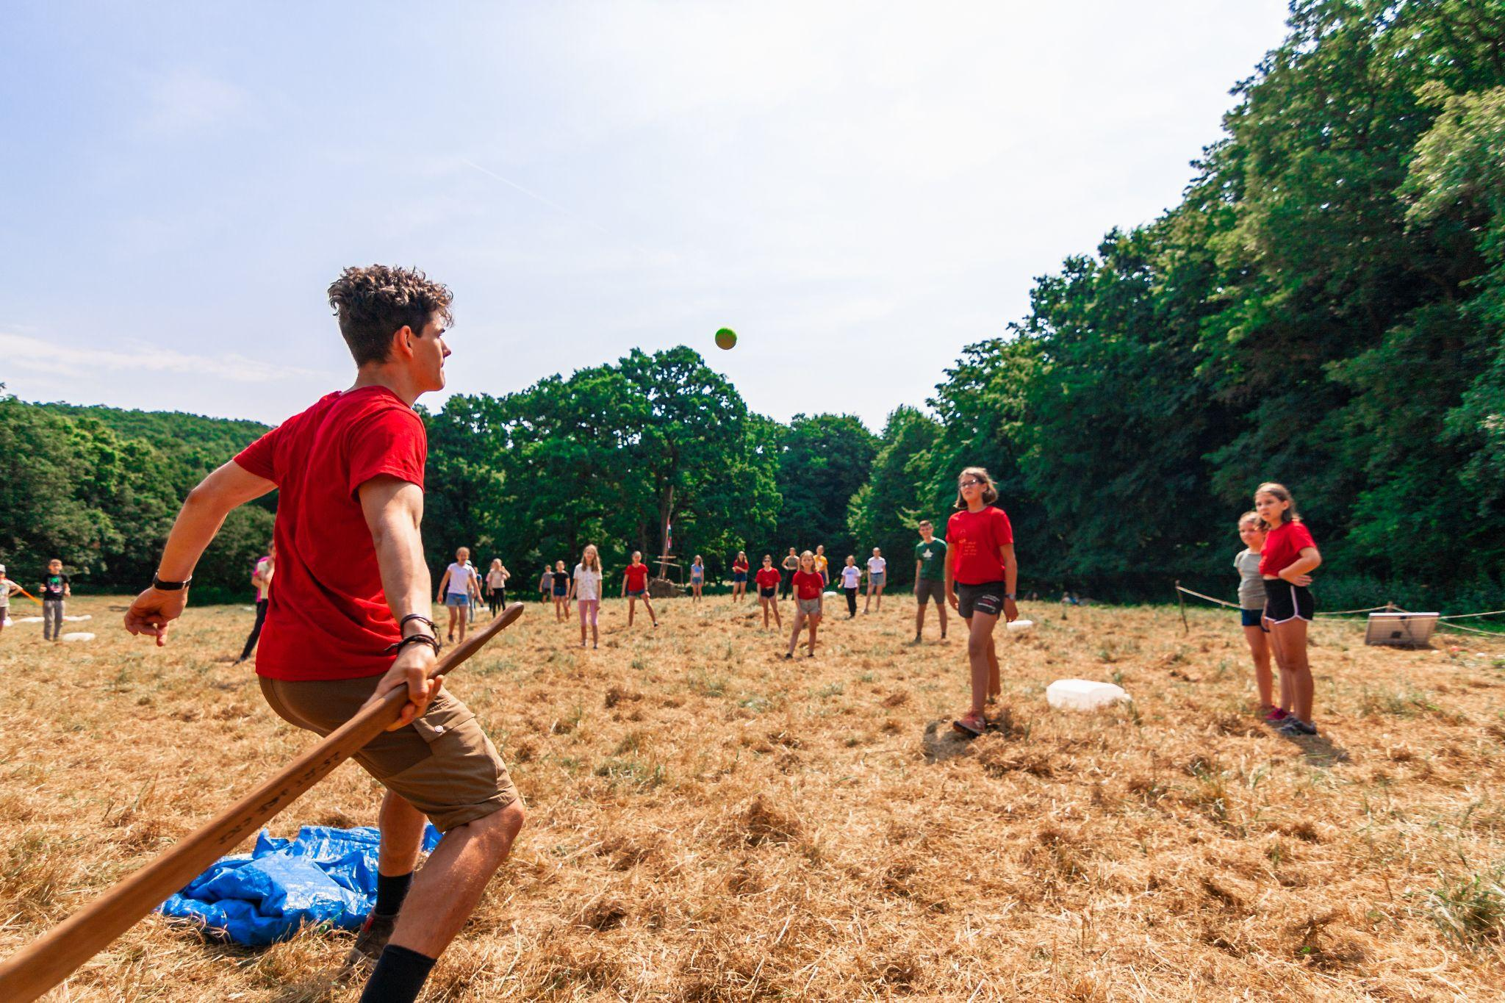
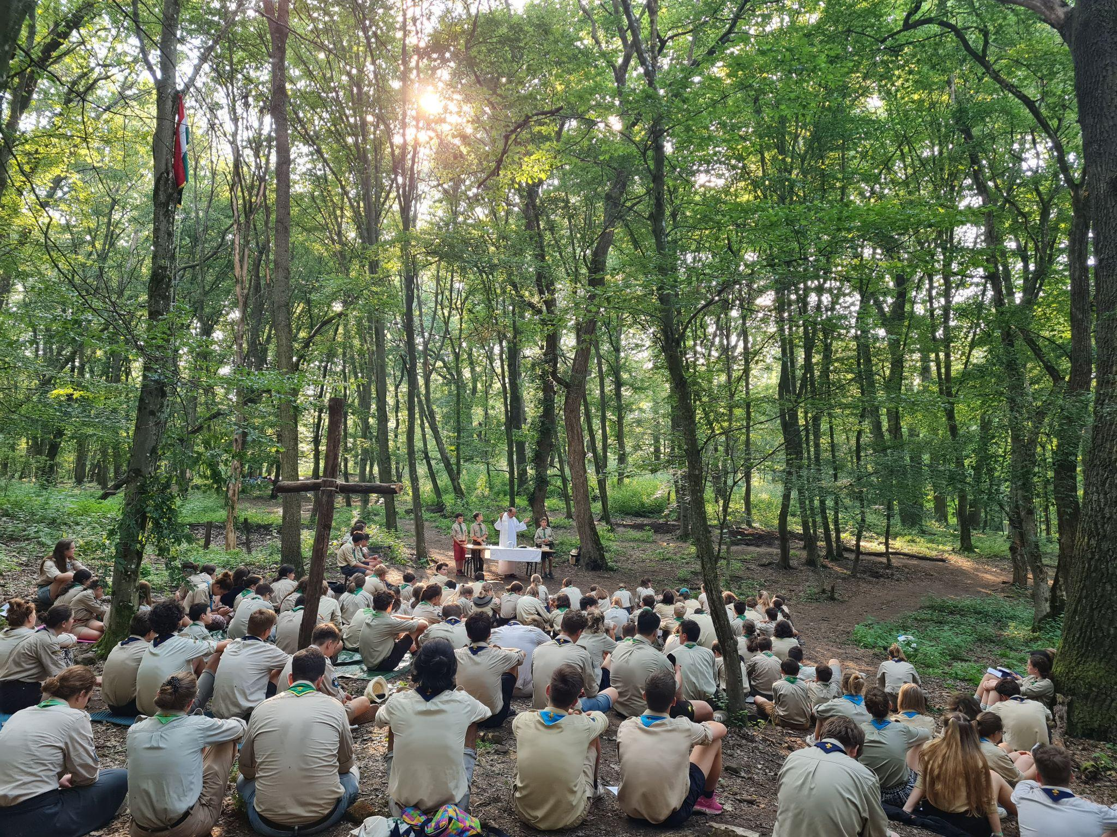
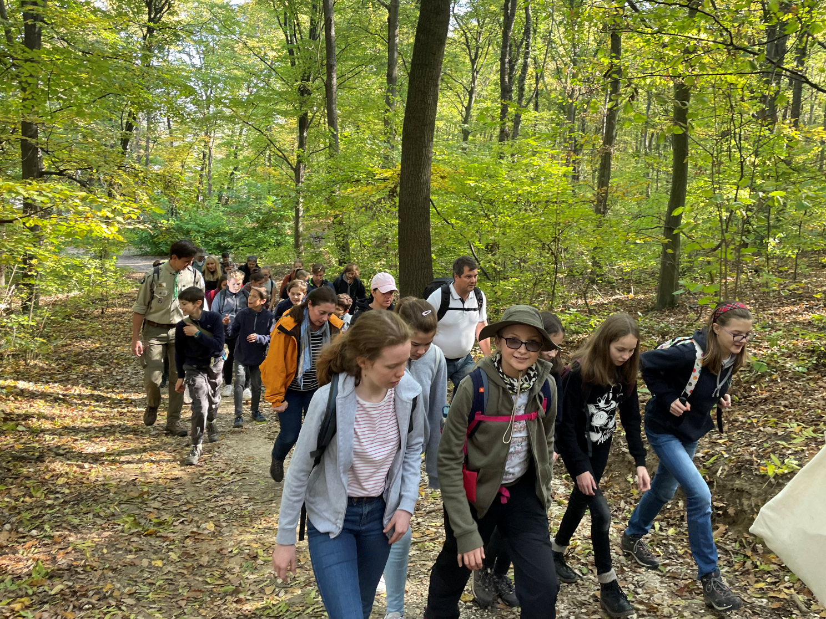
Scouting in Action - Our Activities
“Learn by doing”!
spiritual programs
hikes
sport programs
God, Country, Fellows
Notes:
When organizing programs we always keep in mind the core values of scouting: God, Country and Fellows! So we organize spiritual programs, sport programs, hikes,

Slide 8
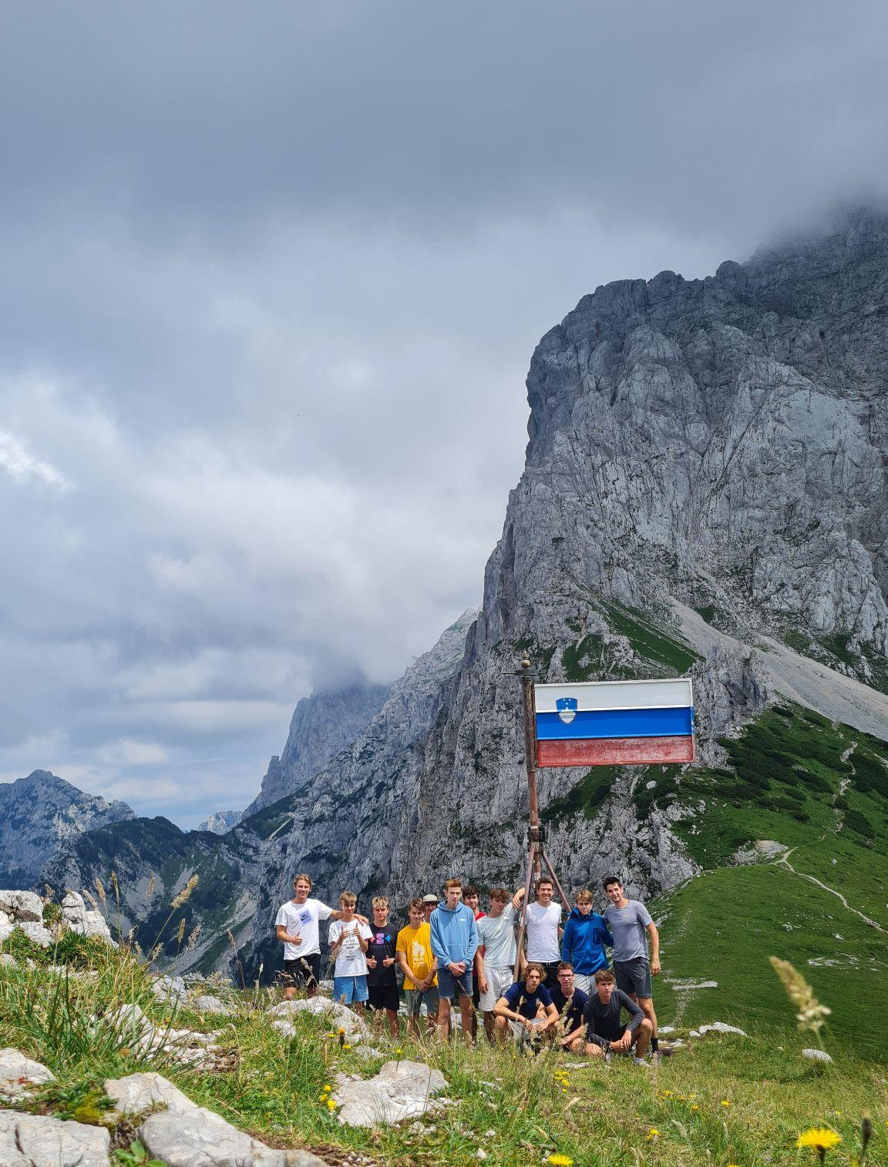
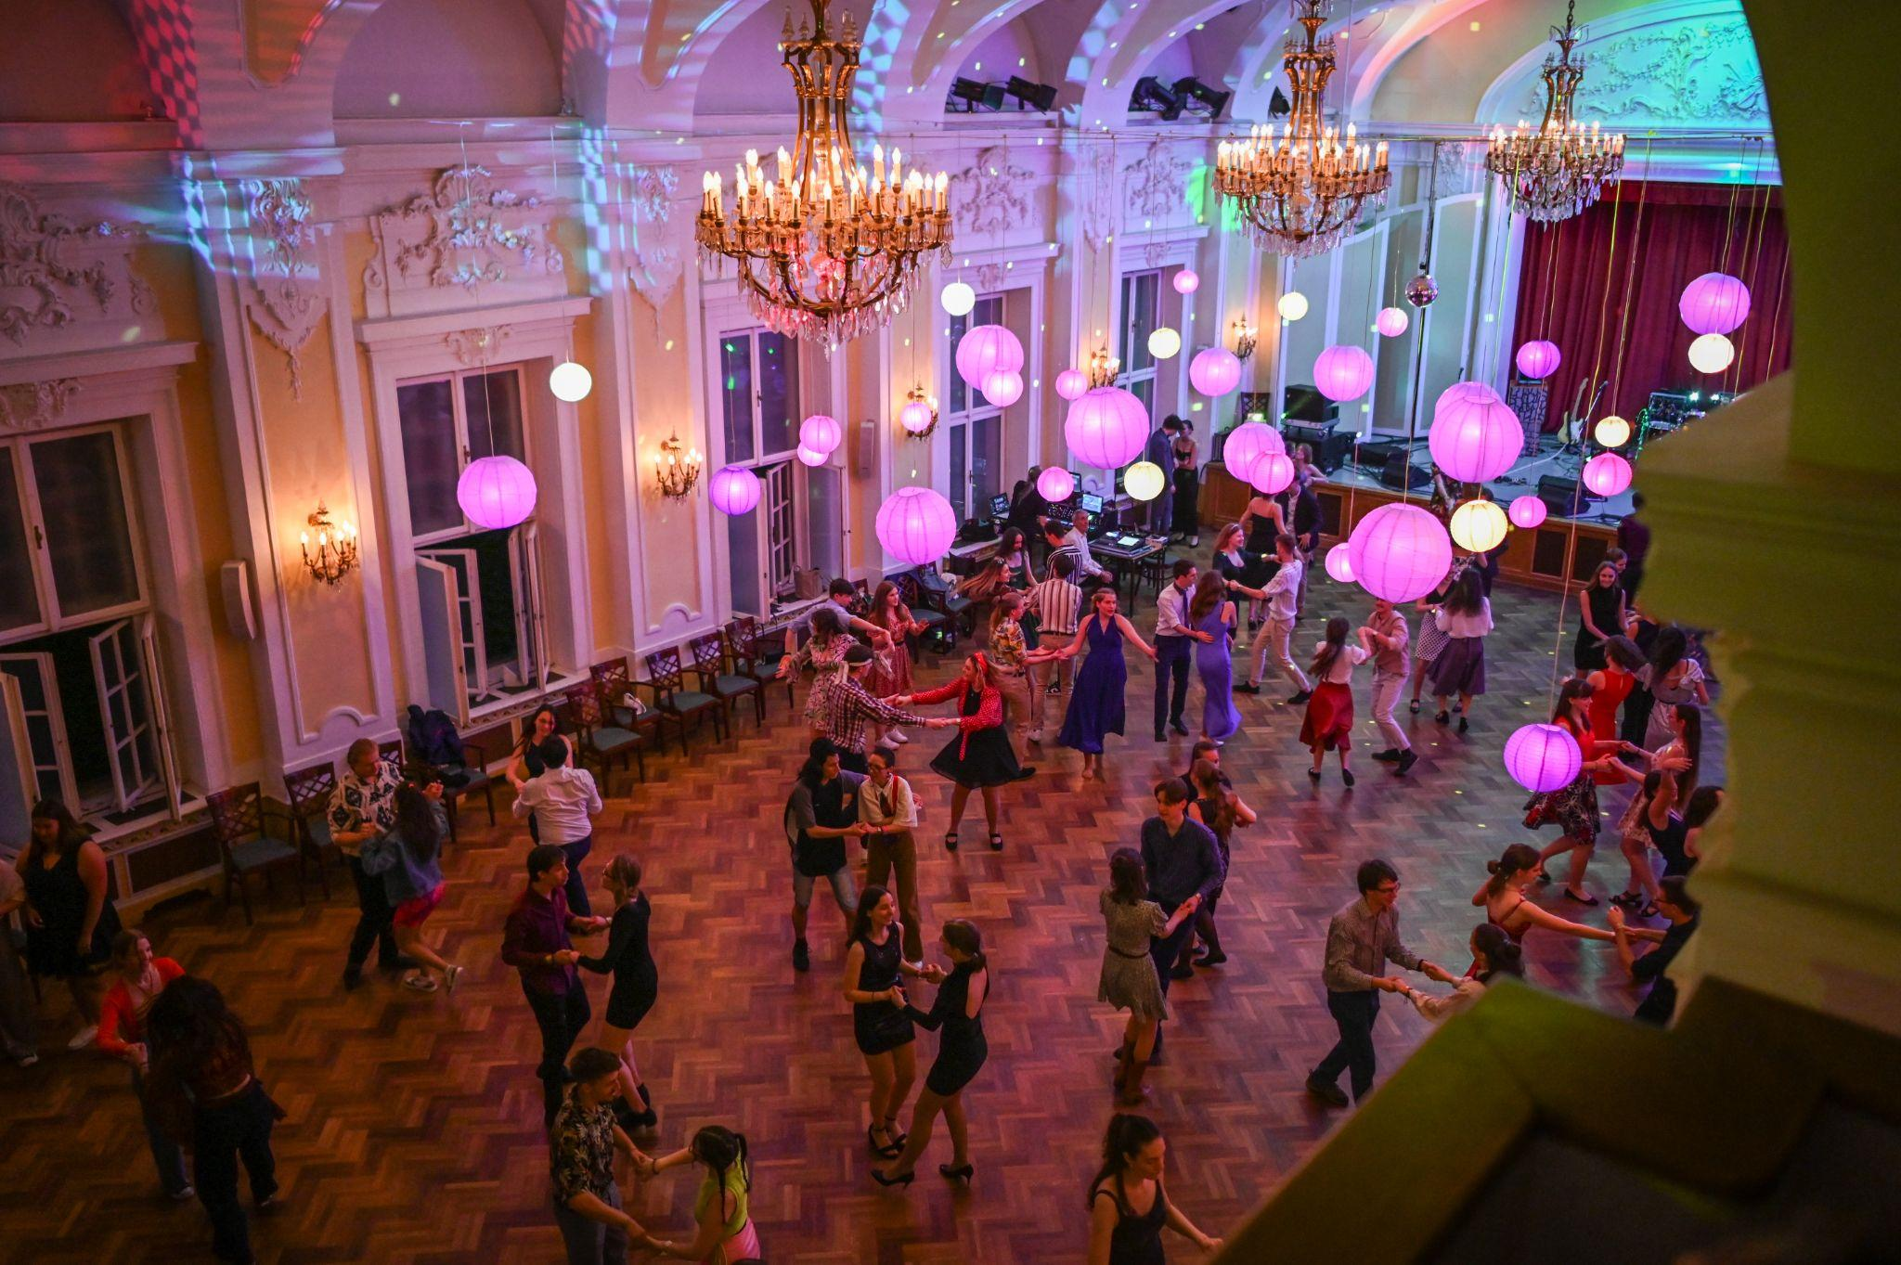
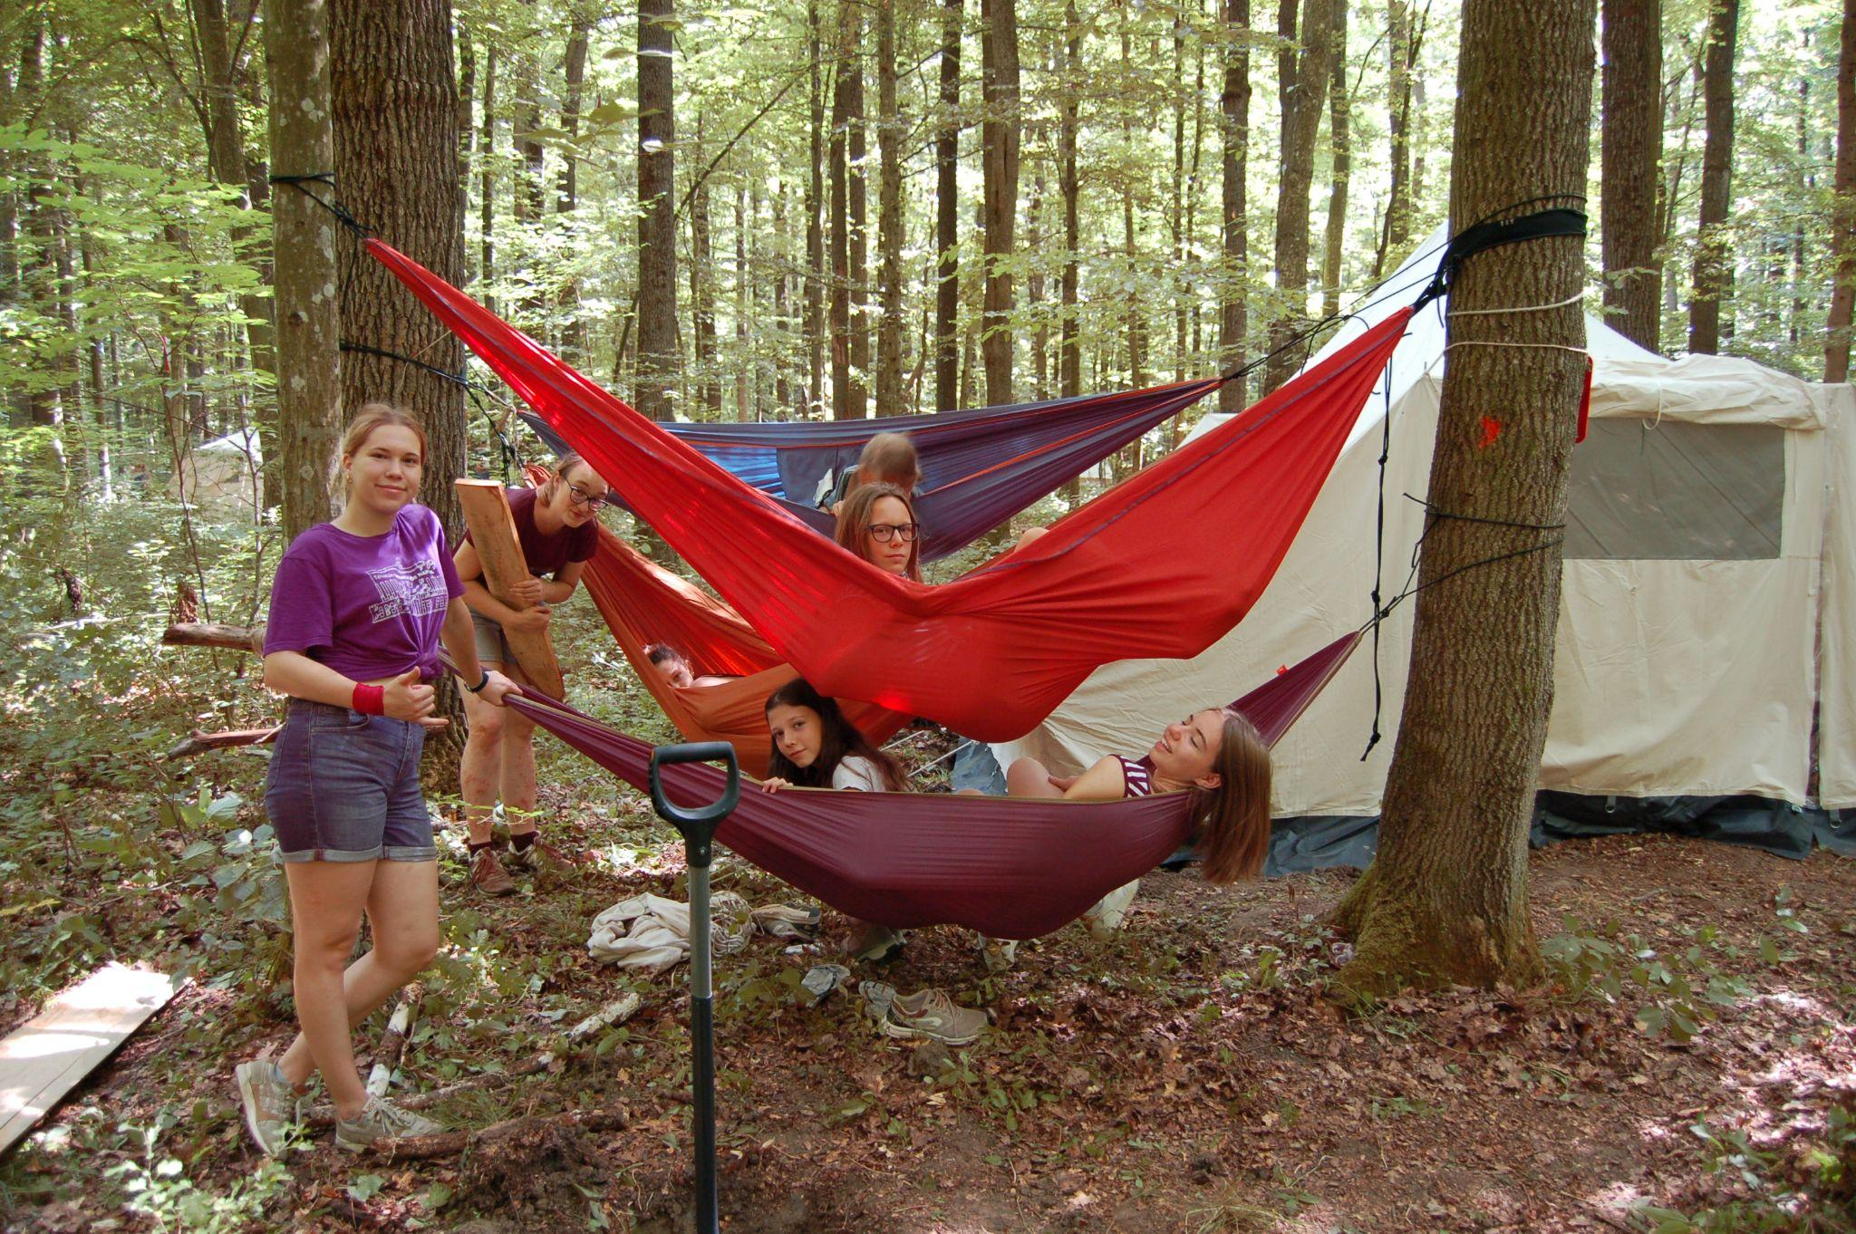
Scouting in Action - Our Activities
“Learn by doing”!
international trips
National Scout Ball
and we don’t forget to have fun… (:
Notes:
as well as international trips for our ranger scouts - this year we went hiking in the slovenian alps. Every year - now for the 30th time - we organize the national scout ball, which is the largest scouting event in hungary each year, reaching almost 1000 participants. The evening serves as a meeting point and cultural entertainment opportunity for scouts from all over the country.

Slide 9
Our Aim and Impact
Responsible
Competencies / Skills
Knowledgeable
Project management
Intercultural
Arts & Crafts
Nature respecting
Communication
Proactivity
Christian
Conflict resolution
Reliability
Socially active, sensitive
Event-planning
Team-work
Leadership
Patriotic
Team building & Education
Notes:
Our aim is to educate the youth to become responsible, knowledgeable, nature respecting, christian, socially active and sensitive, and patriotic. We believe that we help them become such citizens, by exposing them to situations where they can learn competencies and skills such as project management, intercultural competencies, arts and crafts skills, communication skills, proactivity, reliability, team-work, event planning, leadership, conflict resolution, team building and youth development, education and many more.

Slide 10
Szent Imre X Scouting
Current
other initiatives
Cooperation agreement
Main source of newcomers
Programs
Same kids
Similar hardships
Communication between the scout leaders and the School directors
Scout leader X Class teacher
Spiritual education coordination
Child protection (hotline, protocol)
Scouts’ home - under construction
Notes:
Szent Imre Secondary School has been a true partner in developing and educating desirable future citizens. Last year we signed a complex cooperation agreement with Mr. Barlay which framed our long lasting relationship. The School is our main source of newcomers, we advertise our scout troop solely here at Szent Imre, and 95% of our members are current students or alumni. We participate in programs organized by the schools, we work with the same kids, so we have similar hardship, thus, communication is constant between us and the school directors.
It is a truly blooming relationship between the School and the Scout troop, we have several ongoing projects, such as tightening the discussion between scout leaders and class teachers, we want to work together more closely in the areas of spiritual education and child protection.
But i want to highlight the main ongoing initiative, which is the construction of a new scout home in the basement. This marks a truly outstanding point in our collaboration, since this would mean that for the upcoming decades our scout troop and the school will have even stronger bonds. I am happy to discuss more on any matters about our scout troop here at Szent Imre after the presentation, but now i will give the word to András, who will introduce the alumni life.

Slide 11

Alumni life in Buda
What is our role
Challenges and Opportunities
Community
Notes:
"Why does the Cistercian Alumni Association exist?"
To maintain a sense of belonging for alumni as part of the Cistercian family even after leaving their institutions.
To preserve Christian and Cistercian values.
Challenges and Opportunities
Problem of "saturation" among youth.
15% of young Hungarians feel lonely often; 5% always (Youth+ 2023 research).
The importance of real communities as solutions.
Levels of Community
Primary Communities: Schools, choirs, sports, professional workshops, scouting.
Secondary Communities: Loose, episodic connections among alumni.
Tertiary Communities: Online platforms for identity and value alignment.

Slide 12
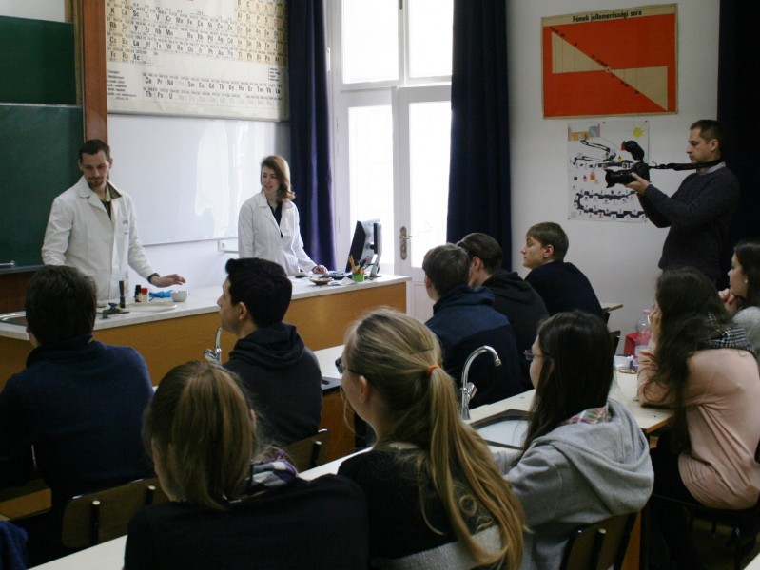
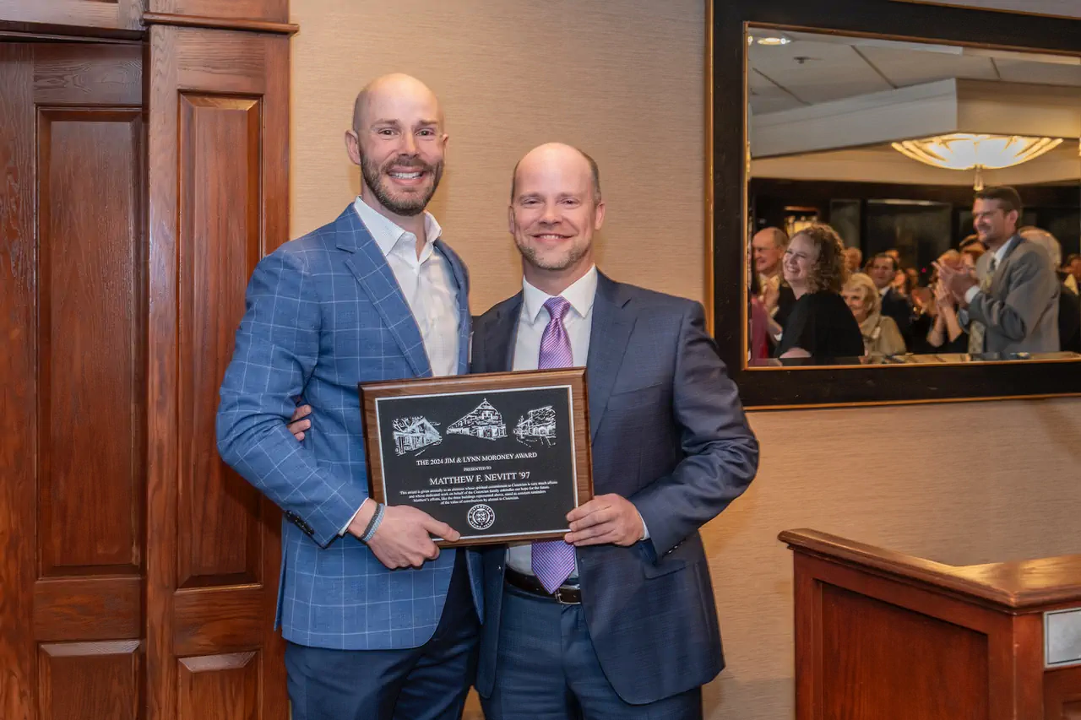
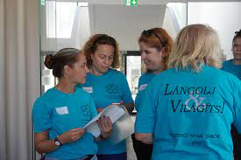
camp organization
study guidance days
donations
Supporting primary communities
Notes:
Supporting primary communities: study guidance days, camp organization, donations.

Slide 13

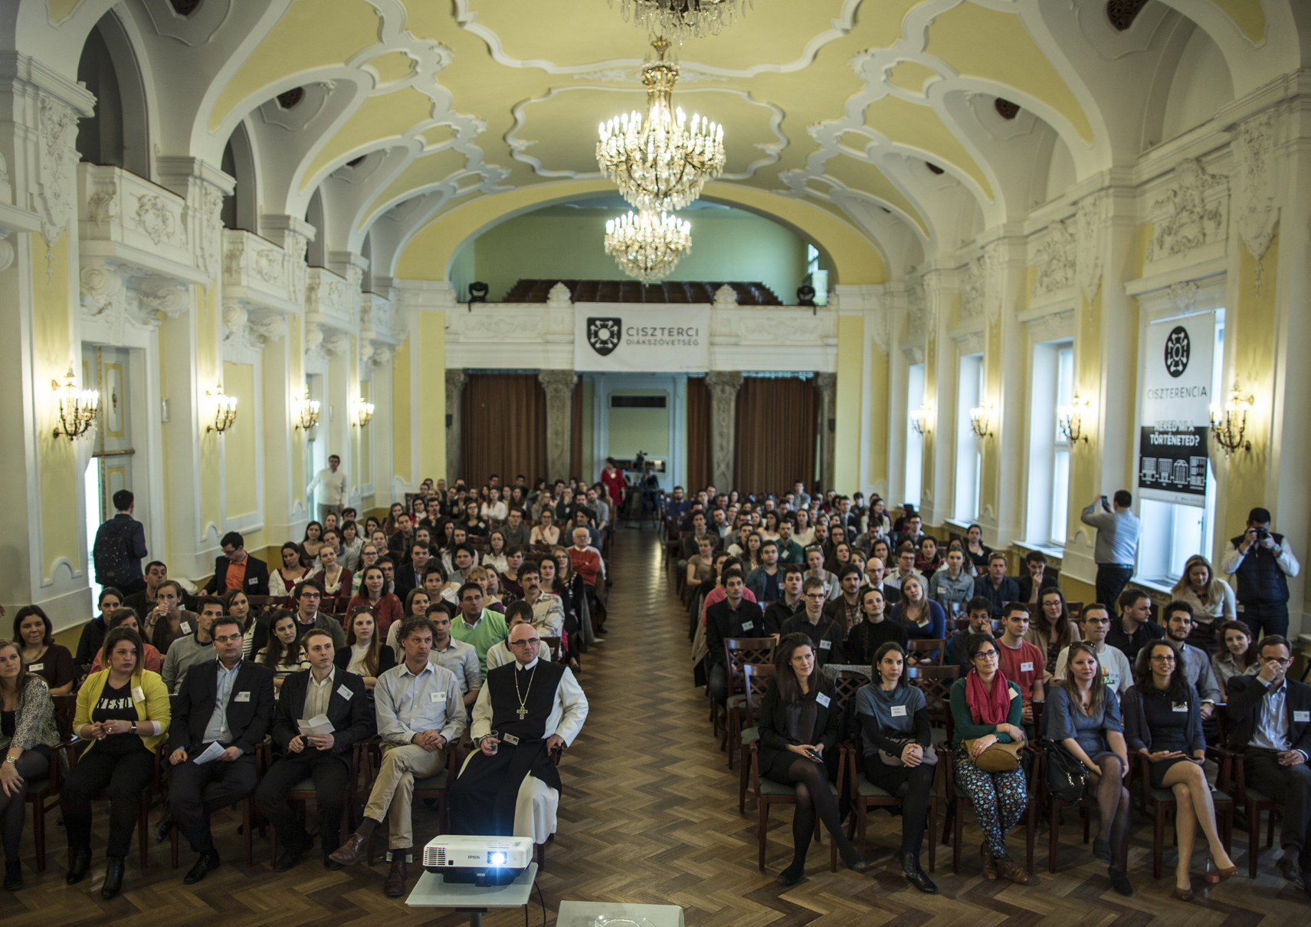
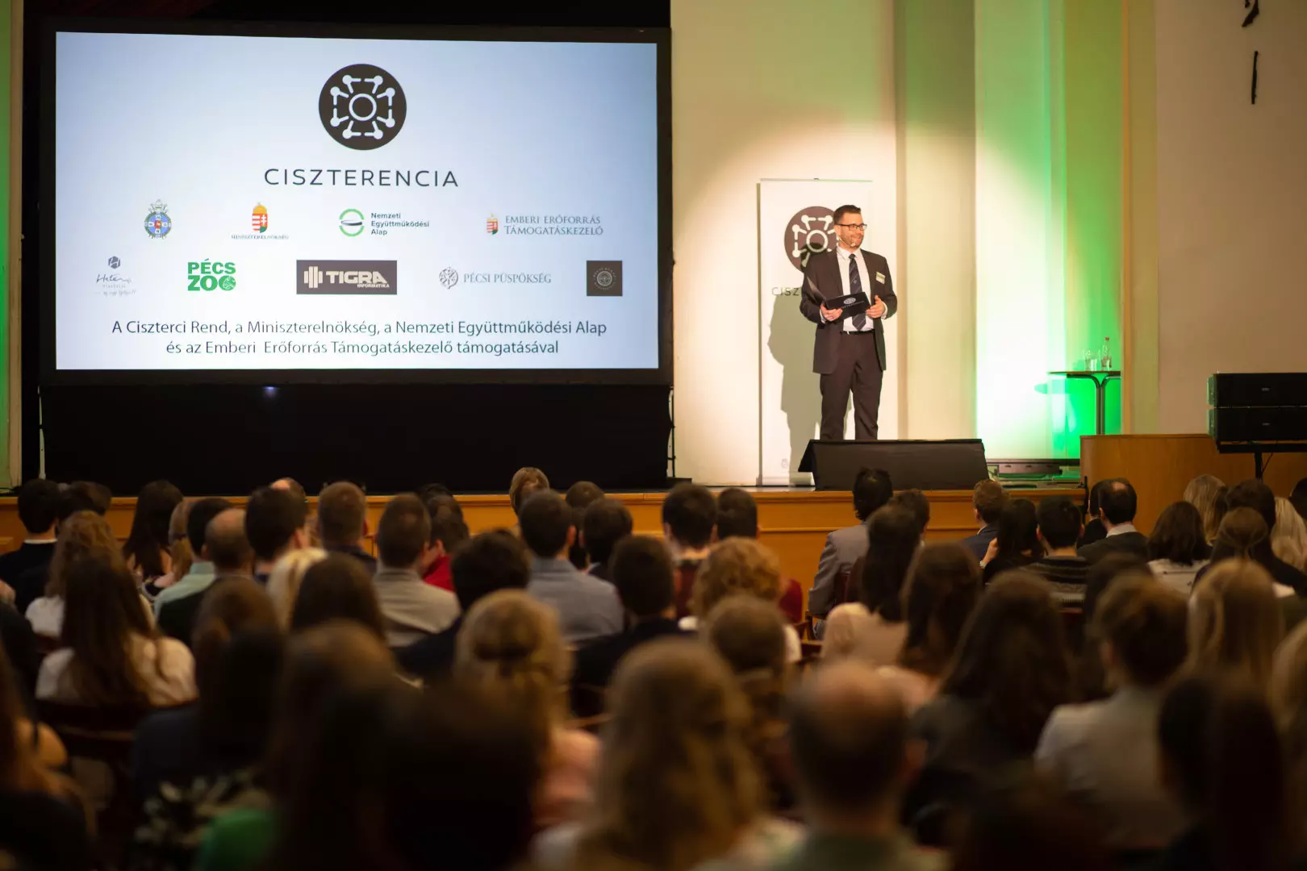
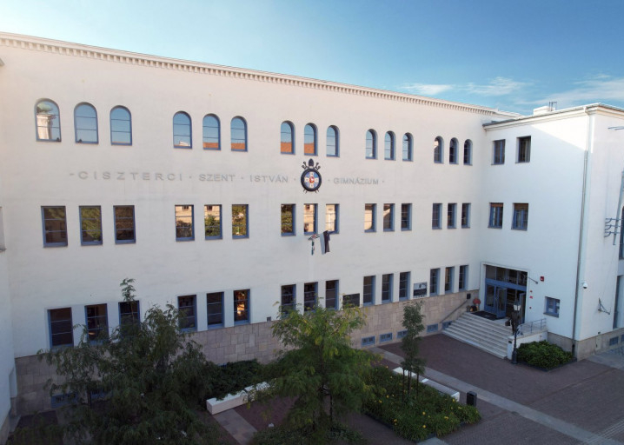
2016 | Buda
2019 | Pécs
2024 | Szfvár
Creating secondary communities: professional networks
Notes:
Creating secondary communities: professional networks, sports events, spiritual dialogues.
Ciszterencia is a one day event, when professionals talk 15 minutes about a topic what moves them. Like TED talks.

Slide 14
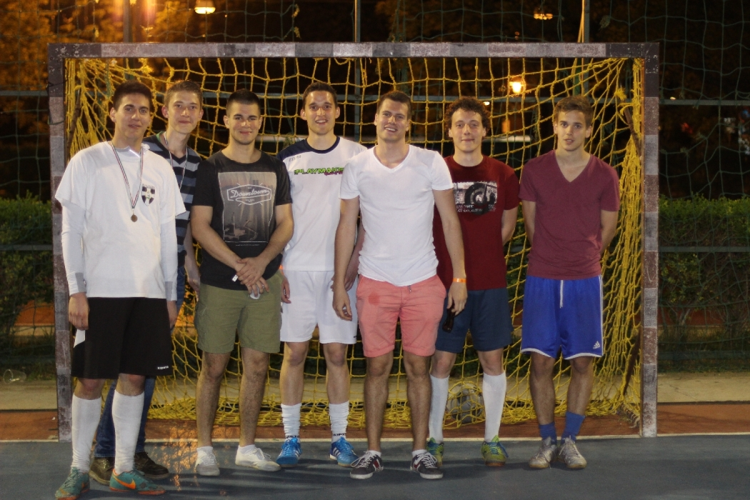
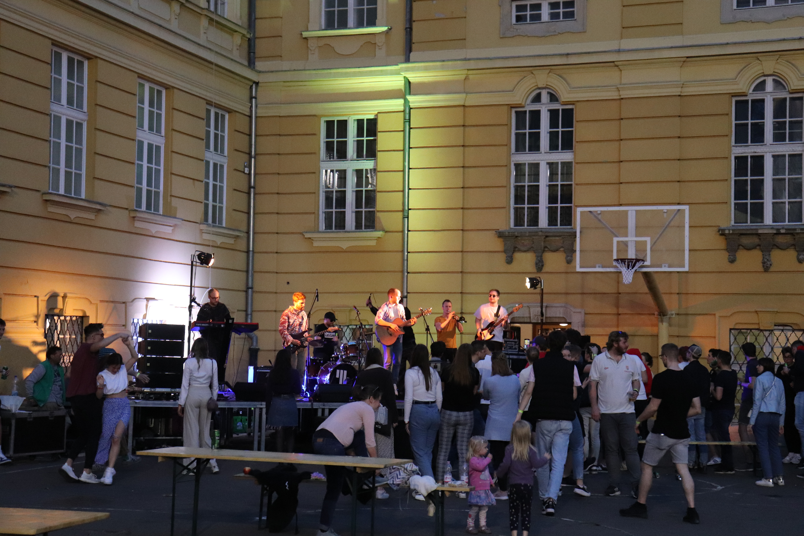
Alumni sports day
Creating secondary communities: sports and cultural
Notes:
Every spring, we organize a full-day sports event. Most of the participants form soccer teams, but we also have ping-pong, volleyball, and basketball. A young team from the alumni handles the organization. They suggested adding a concert to the event. I supported the idea, so they invited three bands formed by former students. It turned out to be a great shared experience for the cohorts who, unfortunately, missed out on communal activities due to COVID.

Slide 15
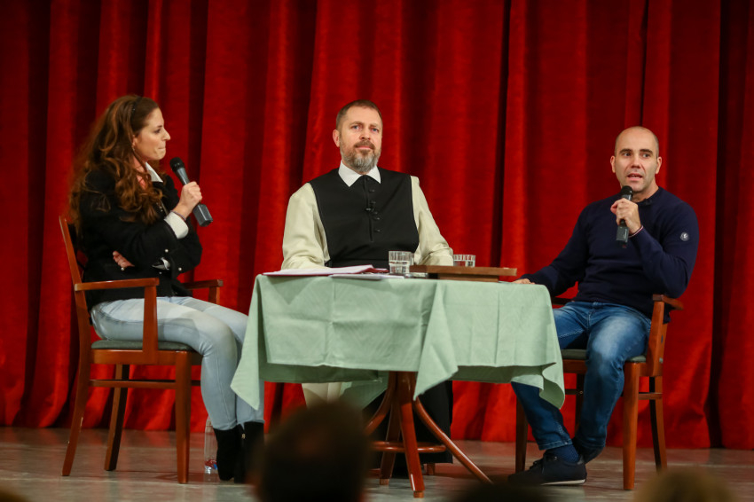
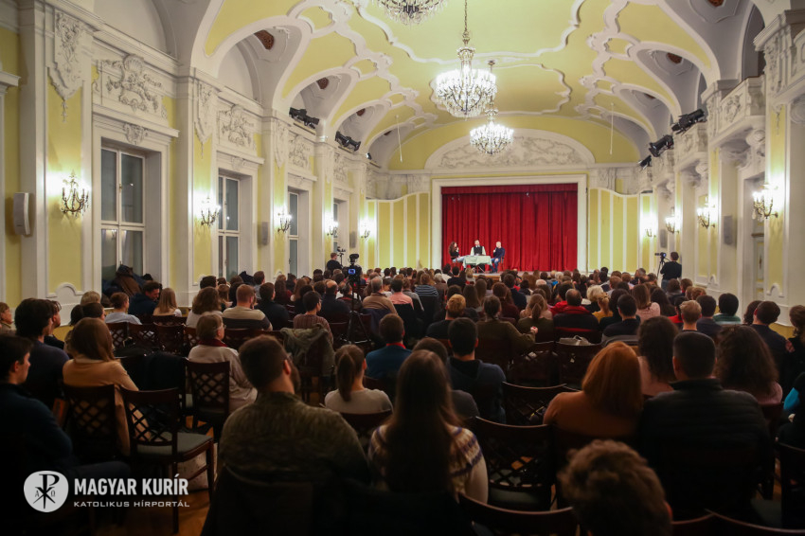
Advent Conversations
Creating secondary communities: spiritual and more
Notes:
Every year, we hold discussions—deep conversations—that bring people closer to both the Cistercian community and the values we consider important.
For example whe invited and alumni, KAP - how is a stand up performer. He and Örs made the day for more than 200 participants with humor, confession and clear communication.

Slide 16
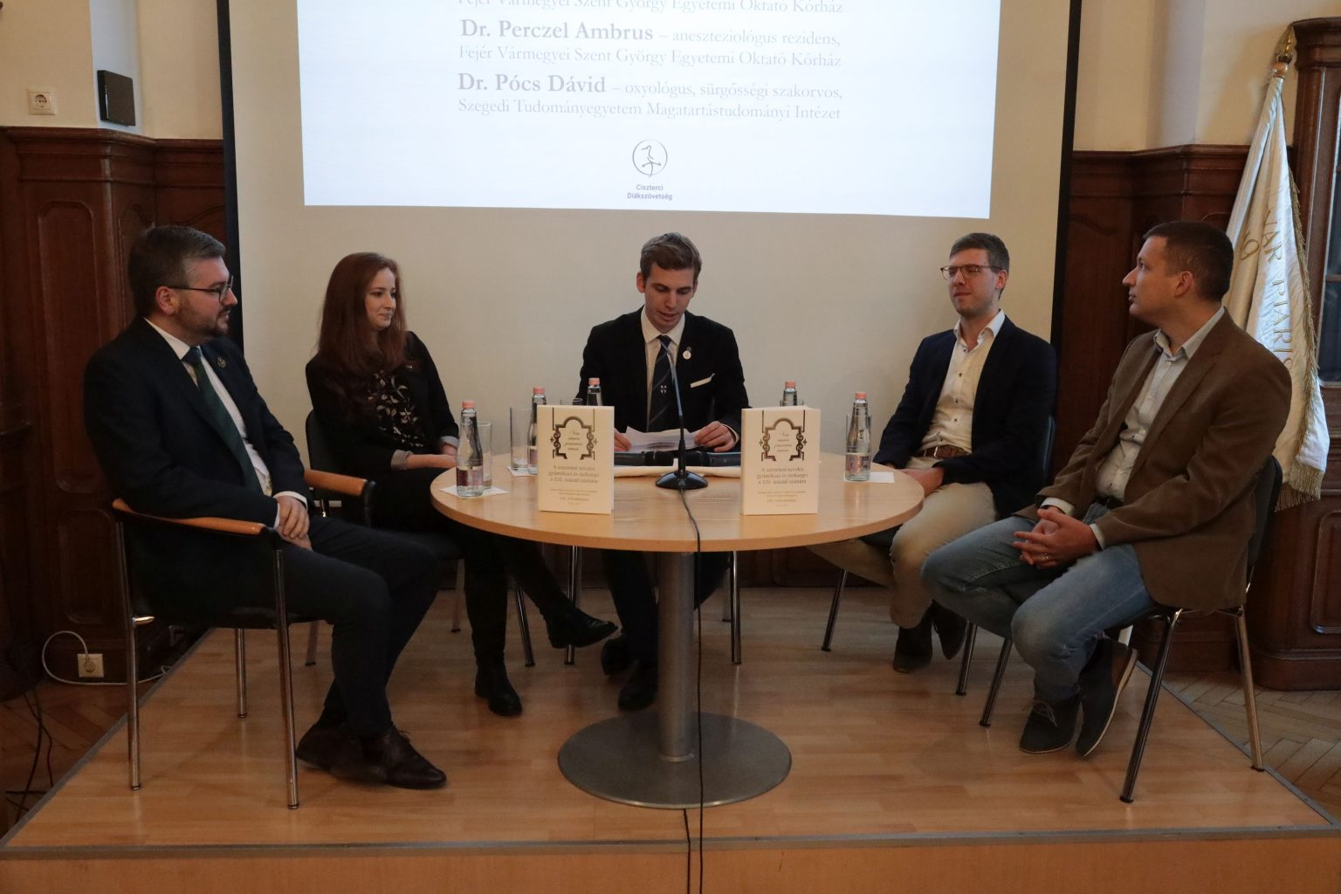
Participation on conferencies - like Alumni round table with MDs
Notes:
Sometimes we receive requests to send alumni to conferences. Last year, for example, on the occasion of the 100th anniversary, every order sent alumni representing a specific profession. Some sent politicians, others engineers, while we sent doctors—one from each of the four schools. The moderator also came from Buda. It turned out to be the best discussion of the entire conference, as our alumni not only spoke intelligently but also in a manner truly worthy of the Cistercians.

Slide 17
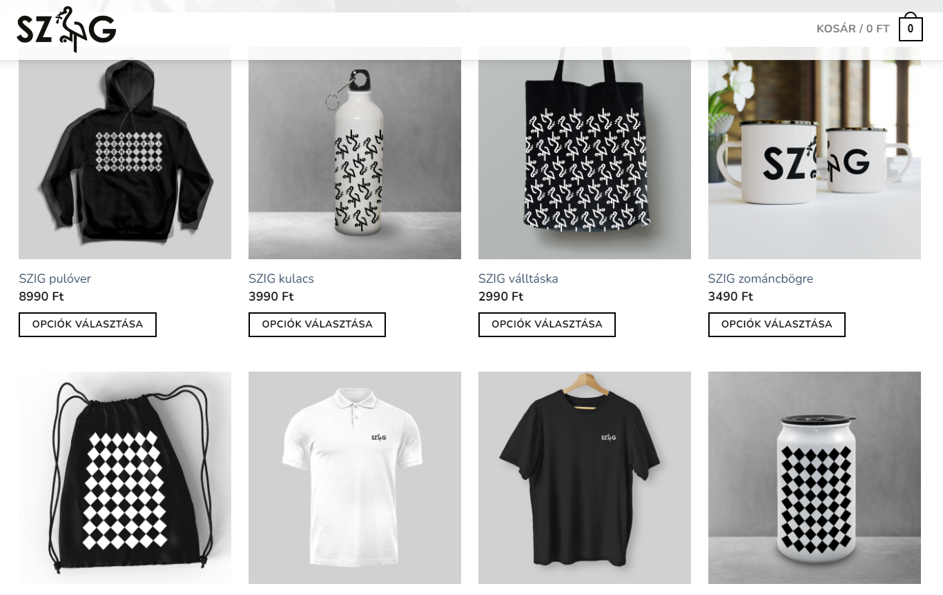
Other techniques to build connections…
Notes:
No only t-shirts or other items, but also platforms.
One of our alumni opened an online shop where products related to the Buda Cistercian school can be purchased. It has become very successful—students and alumni like to wear and use these items.
This serves as a tool to strengthen our shared sense of belonging. Even a simple water bottle is enough to recognize a common connection with a foreigner...

Slide 18

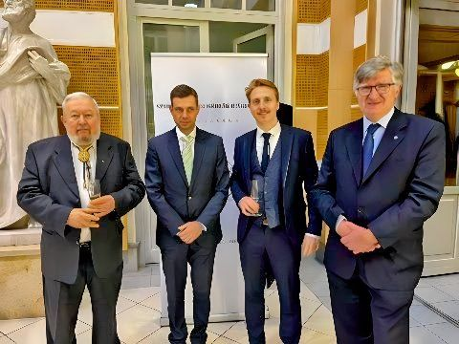
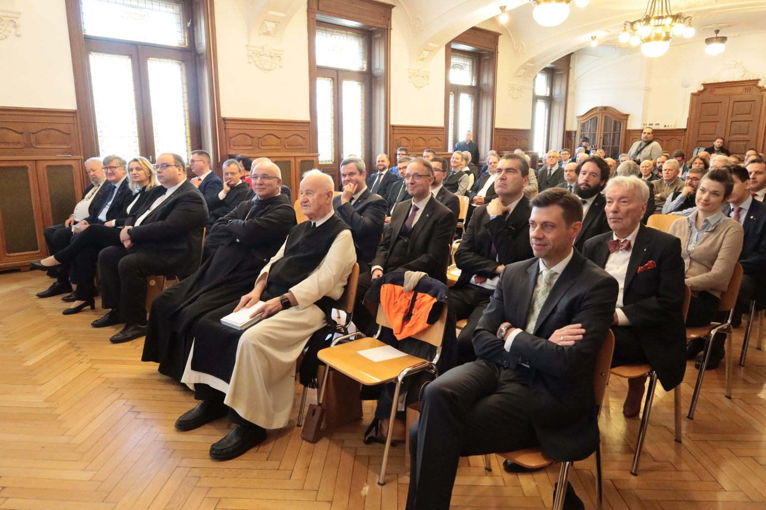
Cooperation with sister associations
Notes:
Cooperation with sister associations and supported by the Cistercian School Authority.
Like Salesians, Franciscans, Benedictines, Piarists, and many others moved by or supported by the Hungarian Ministry of Foreign Affairs

Slide 19
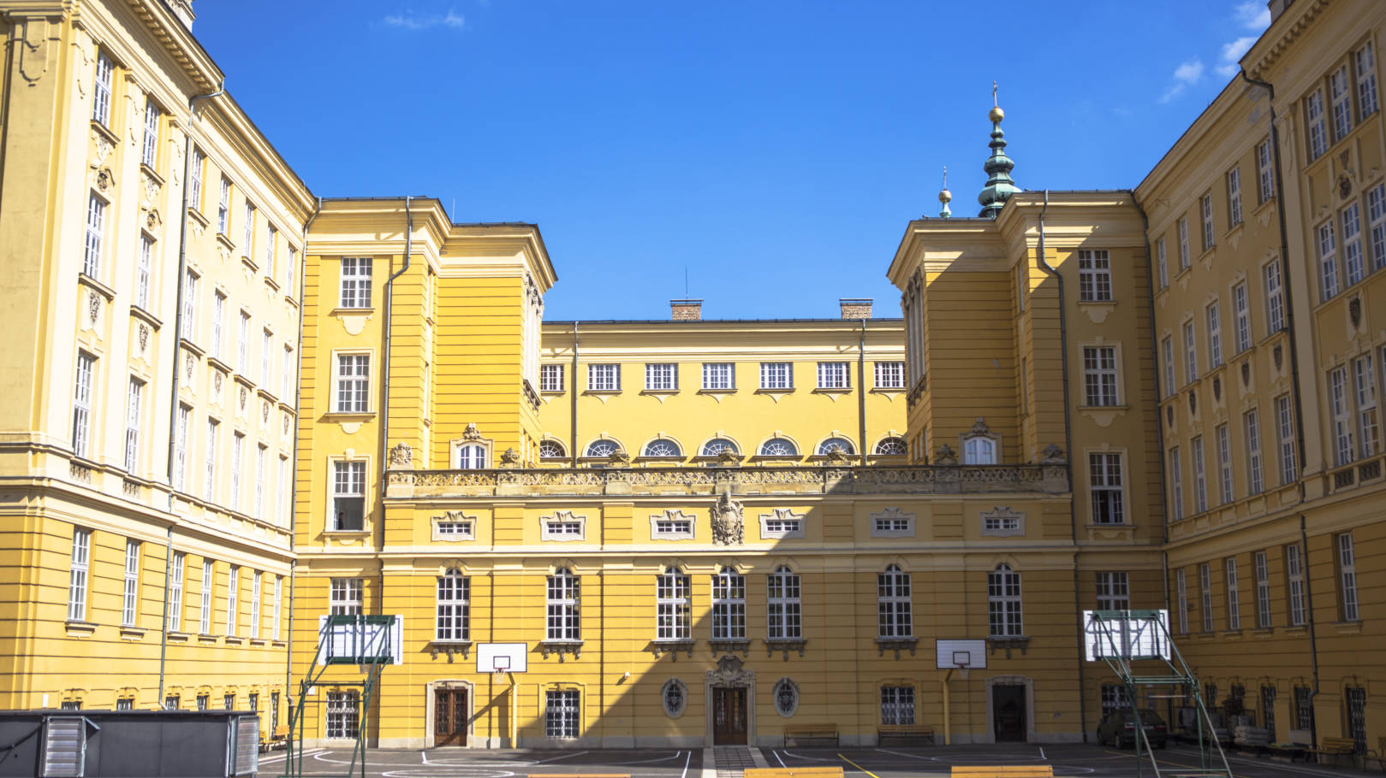
Together
that consists of
we work for a strong
socially active, thinking,
Hungarian Cistercian alumni,
and patriotic intellectuals!
We are open to your questions and ideas!

